Slide 1
Federal Urdu University (Dept. of CS)
Dr. Kamran Ahsan
HCI (Human Compute Interaction)
Non-verbal Communication
(with pictures from Morris, D. “Manwatching”, 1977)
Notes:
Non-verbal communication
CE00355-3 Advanced HCI & Usability

Slide 2
Introduction
Most humans live in a context constructed from their interactions with others.
In other parts of the course you have seen aspects of
‘Contextual Design’ &
the use of ‘Ethnography’ in describing human work contexts, & Ethnography’s interest in >Descriptive accounts< of what is actually done using the vernacular of the context.
A key feature : the researcher takes the role of
‘Observer Participant’ or ‘Participant Observer’
Notes:
Non-verbal communication
CE00355-3 Advanced HCI & Usability

Slide 3
This lecture
In this lecture, we will look at what ‘body language’ is and at some categories of gesture - particularly those of the hands - that can be most revealing. This will lead to discussion about analysing non-verbal communication.
You may also find it interesting to look at work by the zoologist Desmond Morris - “The Naked Ape”(1967), “Manwatching”(1977),
“Gestures : Their Origins and Distribution”(1979).
for material suitable for a non-specialist audience.
(Even earlier, Charles Darwin was one of the first to write about body language in his late 19th century work
“The Expression of the Emotions in Man and Animals” (1872)).

Slide 4
Non-verbal communication
Until comparatively recently, verbal and written language systems were the only ones treated with interest by researchers - e.g. in linguistics
(the exception being sign-language systems developed for use by the deaf).
Increased use of research approaches such as Ethnography, when combined with audio and video recording technology, have enabled researchers to study human behaviour in detail much as a zoologist would study that of animals.
What has become clear is that ‘body language’ or kinesics, provides a revealing commentary on what is taking place in human conversations and meetings.

Slide 5
Signals
Face to face encounters are complex events, in which 60-80% (at least) of the impact is likely to be derived from non-verbal signals.
It is apparent that people make decisions about others based on what they see and how they interpret gestures - exhibited in a range of physical positions from body posture through to the shape of the pupil of an eye. Gestures signal hunting, mating, status, territory, leadership, subordination, rituals & taboos.
As an Analyst & Designer it can be useful to be more aware of other aspects of human communication besides what is said and written, gaining a ‘richer’ picture of the situational context under investigation.

Slide 6
What is Body Language ?
Body language is an outward set of signs of our inner mood.
A single gesture alone is - like a single word - typically meaningless.
To be interpreted, gestures need to be considered as a ‘cluster’.
An ‘ethogram’ is a list of every characteristic movement or posture made by a species. Morris has identified 3,000+ gestures with hands and fingers only (not including formal sign language systems) made by people.
Ethograms can take years to assemble (hence an important role for Ethnography). What is surprising, however, is the tenacity of gestures – they can be carried from generation to generation through a culture for thousands of years even though their original meaning may have been lost.
(the most favoured explanation for the British ‘V’ sign dates it from 1415)
As individuals, we tend to stick to a set of personal body actions that can be as identifiable as fingerprints

Slide 7
Categories of non-verbal signal
Social psychologists have divided non-verbal signals into the following 9 sets :
Facial expression
Gaze (and pupil dilation)
Gestures and other body movements
Posture
Bodily contact
Spatial behaviour (e.g. position in relation to others – my italics)
Clothes and other aspects of appearance
Non-verbal vocalizations (e.g. a sigh – my italics)
Smell
(“Bodily Communication” 2nd Ed. Argyle M., 1988)

Slide 8
Movements using the hands
The precise posture of our hands can tell us a lot about the emotional state of a speaker, and 11 major ‘hand signals’ have been identified :
1) Clenched fist - to make a powerful point
2) The hand ‘chop’ - to cut down a rival proposal
3) A semi-clenched fist - to make a cautious but firm point
4) A ‘pincer’ thumb and forefinger - for precision
5) Palm down - calming
6) Palm up - imploring, begging for help
(also seen in wild chimpanzees)
7) Cupping an invisible ball - disclaiming, protesting innocence
8) A ‘hug’ with hands only - embracing
9) A ‘hug’ extending to whole arms - a more powerful embrace
10) Prodding forefinger - stabbing into submission
11) Wagging forefinger - an imaginary club on the head

Slide 9
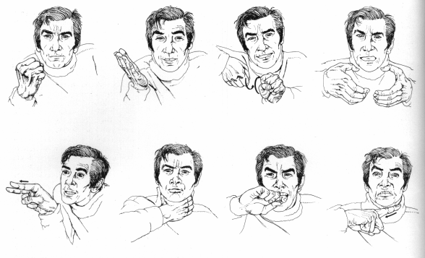
Hand threats

Slide 10
Cultural difference
There are some significant cultural differences in gesture, so, although much body language is more universal than spoken or written forms, it is still possible to give or receive totally the wrong message.
For example :
The sign made by joining forefinger and thumb into an ‘O’ means :
Britain and the USA - okay
Southern France - zero, or worthless
Japan - money
Middle East / Greece /
Sardinia, Brazil - is obscene (origin, over 2,000 years ago)

Slide 11
Expressive faces
Humans have the most expressive faces in the animal kingdom.
Without fur to cling to, human babies need a way of keeping their mother close. Smiling is an inborn mechanism, developing even in babies born blind (so they cannot have learned it) at about 4 weeks. When we are lying, we tend to make fewer gestures but often touch our face – to stop the words escaping.
A liar often uses ‘token scratches’ of the face, which are small actions lacking the conviction of a genuine itch (see non-verbal leakage).
Looking someone in the eyes is a sign of disrespect in Asia, but in our culture you are taught to ‘make eye contact’ when giving presentations !
The eyes are very expressive, and movements of the white parts can be seen at some distance away. Presenters are advised not to wear spectacles if they want to exploit this. In particular, making eye contact encourages an audience to remain more attentive – in normal conversation they would expect to contribute to a dialogue they would be following in anticipation of their ‘turn’.

Slide 12
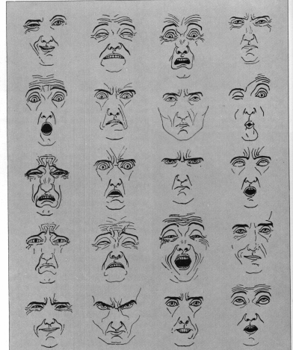
Facial
Expression

Slide 13
Non-verbal leakage
“the failure of the social mask”, resulting from acute inner-outer conflict (Morris, 1977)
(sometimes revealed by excessive activity in one gesture ‘channel’ combined with reduced activity in another).
Generally :
Least easy to detect Words only
Facial expression
General posture (affected by context)
Hand postures (affected by context)
Most easy to detect Legs and feet
Actors can become adept at controlling their body language to avoid ‘non-verbal leakage’.

Slide 14
Leakage & Lying
Lying, for most people, involves at least temporary stress.
It has been found to be signalled by :
A decrease in hand movements
An increase of hand to face ‘autocontacts’, most often : Mouth Cover, Nose Touch (a disguised mouth cover), Chin Stroke, Lip Press, Cheek Rub, Eyebrow Scratch, Earlobe Pull, Hair Groom
An increase in body posture changes
An increase in the Hand Shrug action
Facial micro-expressions

Slide 15
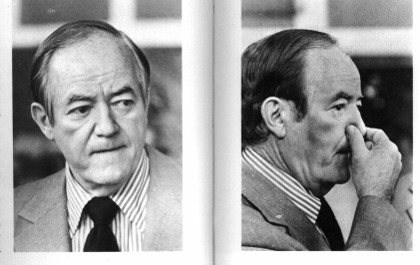
Nose Touch

Slide 16
Tie-signs
From Body Proximity to ‘Movement Synchrony’
or ‘Postural Echo’.
This happens between people and can make us feel ‘part of the tribe’.
In Atkinson’s work (1989) on “Conversation Analysis” (in Politics), he has shown that applause, for example, tends to be started by an individual and then is rapidly picked up by the rest of the audience, quickly building into a crescendo which lasts between 7-9 seconds.
Postural echo is usually only possible between people of equal status - matching alertness or relaxation, frequently synchronising their movements. (Also used by dominant people to put subordinates at ease).
‘Microsynchrony’ of the rhythm of movements (not the exact posture) is often performed within 1 / 48th of a second !

Slide 17
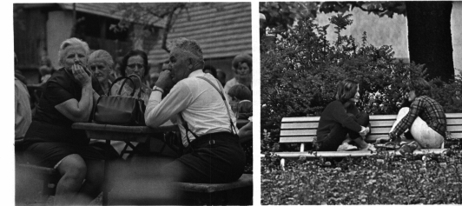
Postural Echo

Slide 18
Joining in
It is very uncomfortable for people if they mistake or misunderstand the points at which ‘responses’ such as these should be made - for example if they clap too early during a performance - because it shows ignorance of how to behave properly.
Performers such as politicians generally provide enough clues and ‘leading’ elements to prepare an audience to respond e.g. in rhythmic speaking ‘triads’ (lists of three) of phrases or repetitions :
“spend and spend, and borrow and borrow, and tax and tax”
(Tebbitt, 1983).
(this acts in the same way as ‘Ready’ ‘Steady’ ‘Go’)
Music is also often present, sometimes as a subliminal signal.
(When the music stops, take your seat) - making it possible for individuals to join in and make exactly the same actions at the same time.

Slide 19
Analysing non-verbal communication
Assuming that video recording(s) are available, how could an analysis of the body language be done ?
Individual gestures are not important, but clusters of them taken in context are. A gesture can occur in combination with different others to lead to different conclusions e.g. deception is suggested by increased body activity (fidgeting), but what if someone is genuinely physically uncomfortable ?
The scientific method requires that gestures are ‘coded’. Each gesture (cluster) needs to be well-defined for co-researchers so that they can agree when it has been displayed. A subset of non-verbal behaviours have been identified over the last 30 years or so which appear to be highly reliable in terms of distinguishing between intentions e.g. gazing at an interviewer or other person, ‘playing’ with objects, body rocking or foot movements.
The quantity of data to be analysed can be enormous (taking hours to code just a few minutes). Researchers can be trained to deal with one ‘channel’ e.g. vocalizations, facial gestures, leg movements, for which they can record the type of gesture, when it began, how long it lasted, its frequency.

Slide 20
Potential problems
Much body language has to be interpreted in terms of what has been evident on previous occasions.How to establish a baseline or benchmark ?
When does the analysis begin and when does it stop ? The ‘Hawthorne Effect’ can be most prominent in the early part of a research session, while the subjects are very much aware that they are being observed. Over a period of time, they tend to ‘settle’ and become ‘more natural’.
(A big advantage of an Ethnographic study is that the researcher (s) can become part of the environment instead of separate entities - may be ‘ignored’.)
By separating researchers into different channel specialists, ‘cross-channel’ effects may be missed or overlooked. This undermines the idea that indicative gestures occur in clusters that often combine multiple channels.
Researchers are human, bringing with them their own set of behaviours that can influence a study & the interpretation of data. By studying different aspects of non-verbal behaviour in oneself and ones reactions to different individuals, it becomes possible to contribute to the production of a ‘researcher biography’ - may be used to ‘calibrate’ findings.

Slide 21
Summary
We’ve looked at :
A range of nonverbal behaviours, from simple hand gestures through signs of non-verbal leakage & tie signs.
Some problems with analysing non-verbal communication.
Some implications for interactive systems :
It is easier to deceive when remote from other people.
Without the availability of visual signals, emotional expression is dampened. Is e-mail one of the most successful applications not only because it places roughly equal demands on all users, but also because users have invented emoticons to enable communication nuance ?

Slide 22
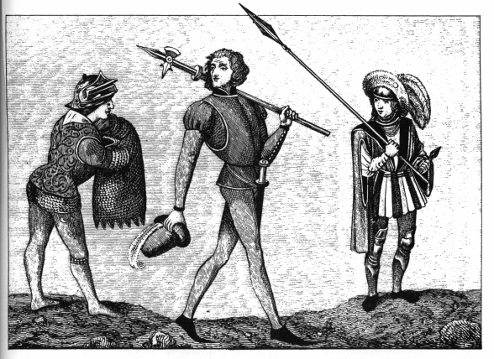
Costume
In the 15th century, it was illegal for a knight under the rank of Lord to wear a short tunic or shoes with points longer than 2 inches

Slide 23
Directed Reading
Preece et al “Interaction Design - Beyond Human-Computer Interaction” (2002) Wiley Chapter 4 - Designing for Collaboration & Communication
Dix et al “Human Computer Interaction” 2e (1998) Prentice Hall Chapter 13 - Groupware

Slide 24
Further references
“Our Masters’ Voices” Atkinson M., 1989 (lib ref. 324.73)
“Bodily Communication” 2nd Ed. Argyle M., 1988
“Systems Analysis & Design” 5e Kendall & Kendall, 2002
(extract from Chapter 7 will be used in tutorials)
“The Secret Language of Success” Lewis, D. 1990
“Body Language” Pease, A 1984
The Center for Nonverbal Studies provides an excellent site covering a range of non-verbal behaviours via :
http://members.aol.com/nonverbal2/nvcom.htm
For views of non-verbal communication in another culture :
http://www.shinnova.com/part/99-japa/abj17-e.htm
http://virtualtimes.com/writers/ueda/thenon.htm

